Slide 1
Traffic Sign Detection
Group 5:
Collin Cleary, Logan Costa, Ben Simonds

Slide 2
Introduction and Background
Problem:
Develop Traffic Sign Detection System using computer vision models
Models:
U-Net
Used primarily in biomedical applications
Mask R-CNN
Used in various applications, including motion capture and autonomous driving

Slide 3
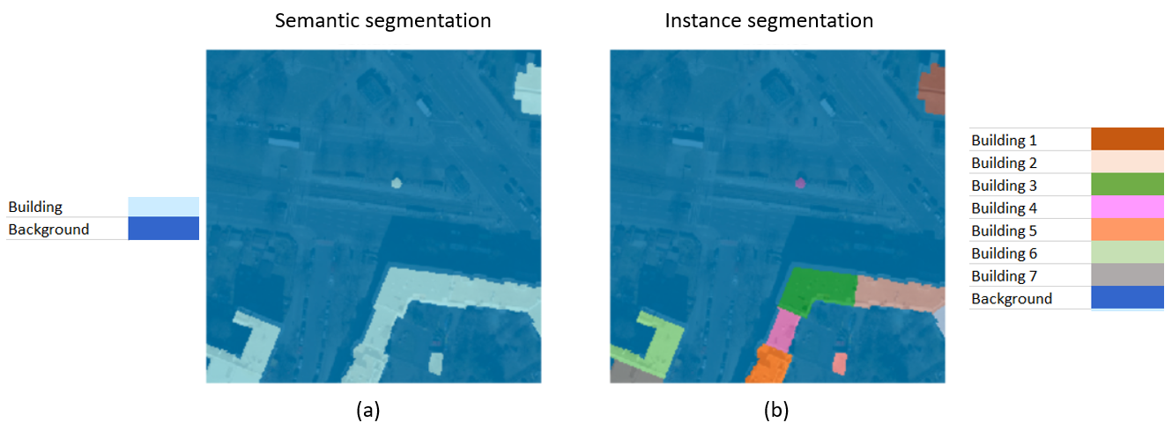
Hypotheses
U-Net will perform better with semantic segmentation
Sign vs. background
Mask R-CNN will perform better with instance segmentation
Detecting individual signs

Slide 4
The Dataset
Initial dataset: made for YOLOv8 with bounding boxes.
Good for Mask R-CNN
Bad for U-Net
New dataset: https://www.kaggle.com/datasets/viacheslavshalamov/russian-road-signs-segmentation-dataset
Precise pixel maps
Good for Mask R-CNN
Good for U-Net
Binary dataset (sign vs background)
Notes:
Downsides: classes were declared in difficult to parse .jpg_coco.json files. As a result, we could only treat the dataset as binary (sign vs background) using the VIA files

Slide 5
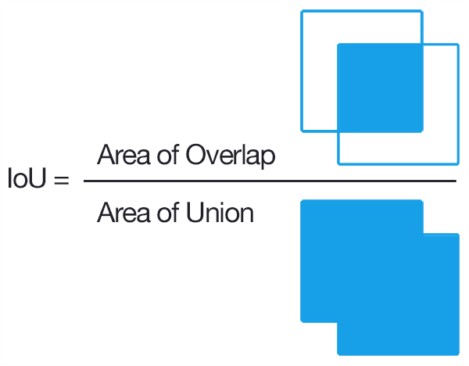
Evaluation
IoU (Intersection over Union)
Precision
Accuracy of positive predictions
Recall
Sensitivity / True Positive Rate
F1 score
Combines Precision and Recall - must score high on both
Notes:
IoU measures overlap of expected vs actual bounding boxes. Precision measures positive predictions vs true positives. Recall measures true positives vs all actual positives. F1 combines Precision and Recall.

Slide 6
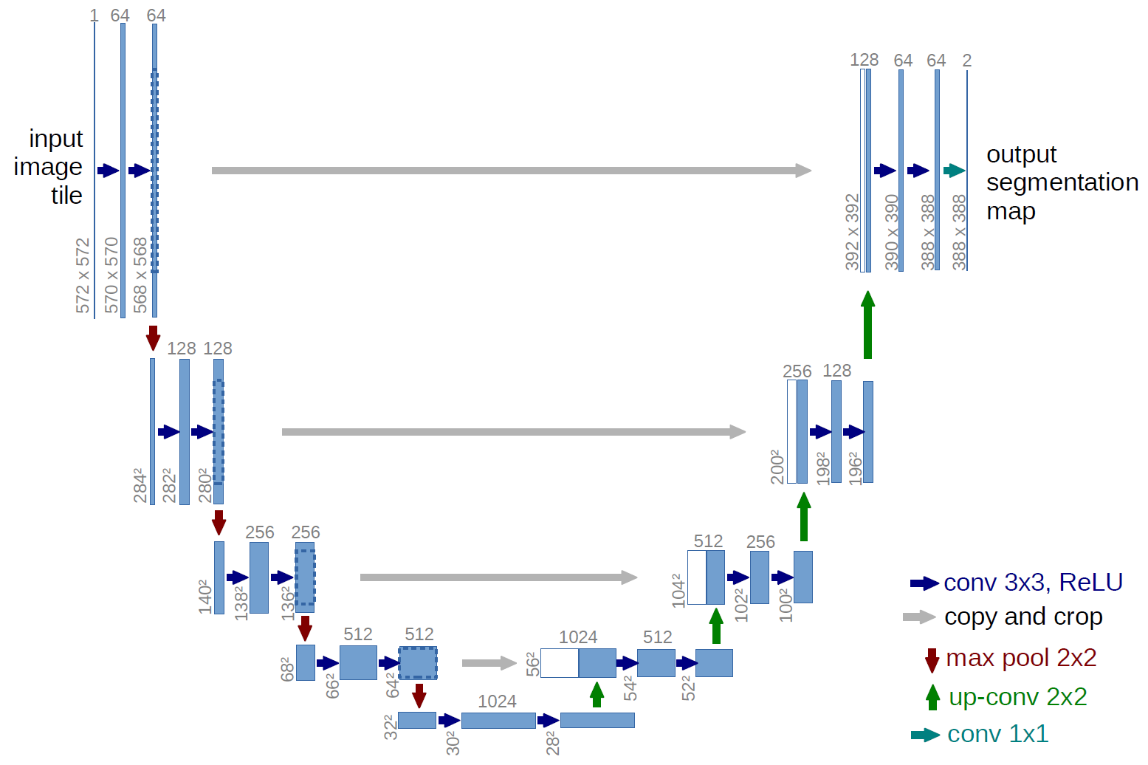
U-Net
Convolutional Neural Network
Predict categories/classes
Classify each pixel
Contracting and expansive paths
ReLU activation function
up-convolutions
Notes:
U-net is a convolutional neural network that was made for image segmentation. In our case, it tries to predict which categories or classes each pixel belongs to. The network consists of a contracting path and an expansive path, which gives it the u-shaped architecture. The contracting path is a typical convolutional network that consists of repeated application of convolutions, each followed by a rectified linear unit (ReLU) and a max pooling operation. During the contraction, the spatial information is reduced while feature information is increased. The expansive pathway combines the feature and spatial information through a sequence of up-convolutions and concatenations with high-resolution features from the contracting path.

Slide 7
U-Net details
Processed the pixel mask data from the via_region_data.json into pngs for easier and faster comparison to predicted masks.
Transform images and masks to a size of 256x256.
20 epochs at batch size 8 (takes around 15 minutes)
Learning rate: 1e-3
Calculates and displays training loss, validation loss, IoU, precision, and F1 in every training epoch.
5-fold evaluation on validation set after training

Slide 8
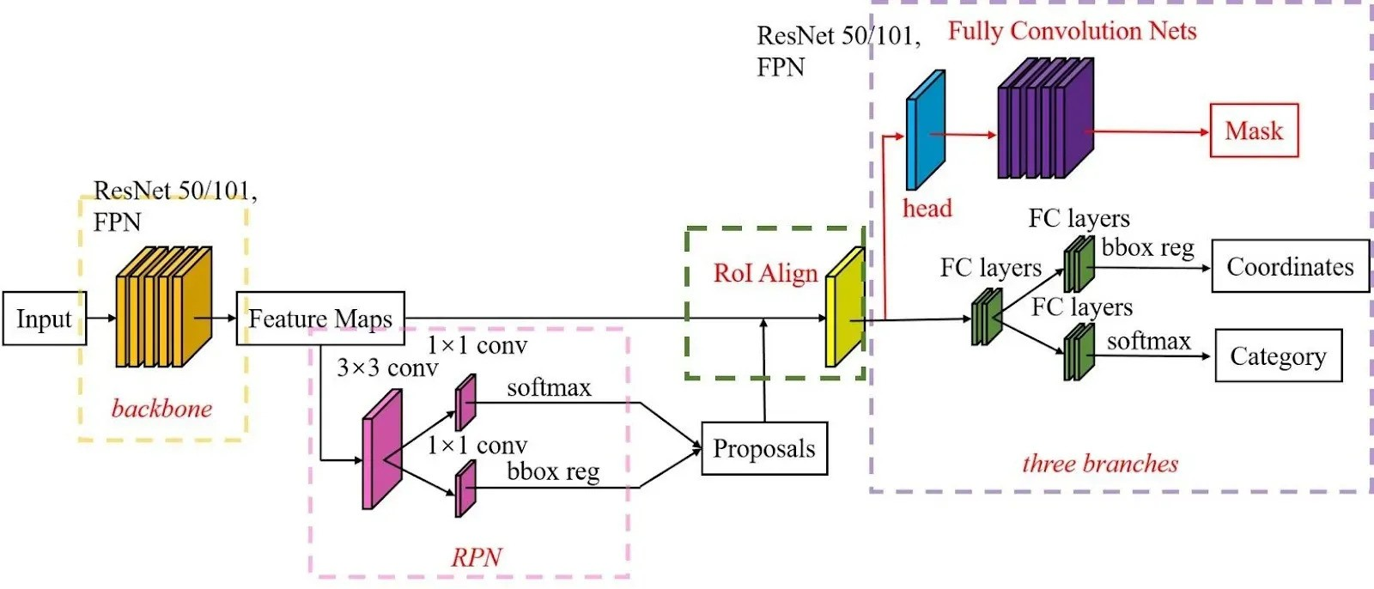
Mask R-CNN
Region Proposal (backbone) Network (RPN)
Region of Interest (RoI) Align
Object Classification, Bounding Box Regression, and Instance Segmentation

Slide 9
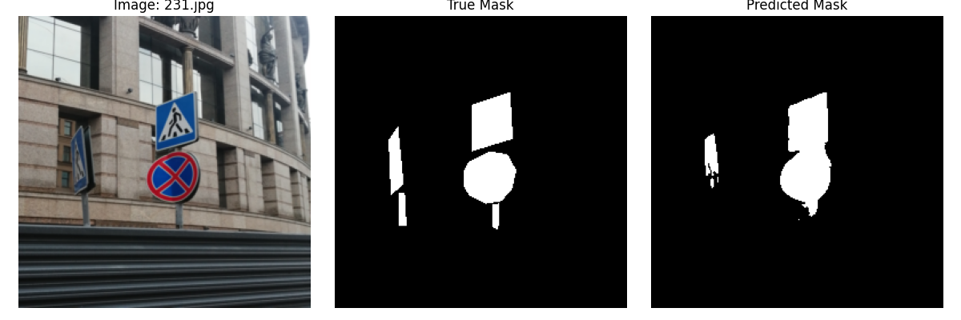
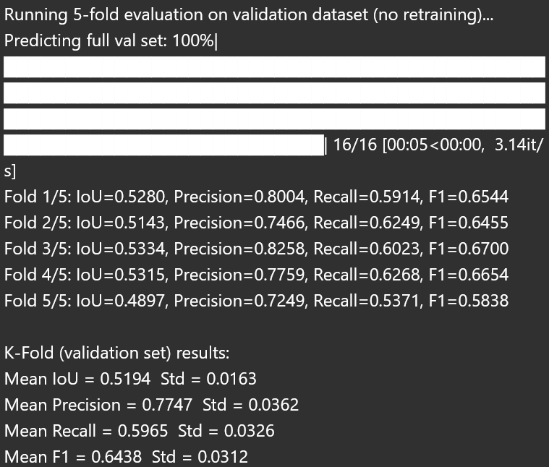
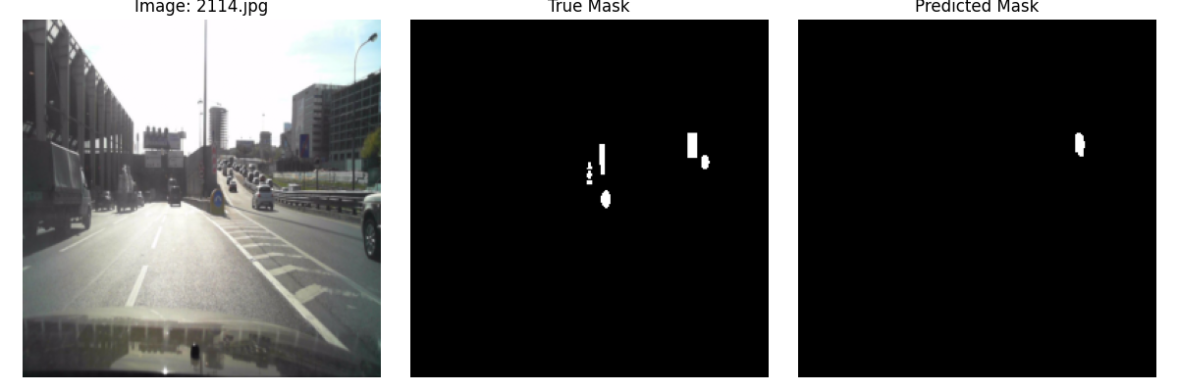
U-Net Results
Key Results:
IoU=0.5194
Precision=0.7747
Recall=0.5967
F1=0.6439
Notes:
These images were made to visualize the performance of the model after the 20 epochs of training and validation. In the lower image, there are many small distant signs and it seems like the model can’t recognize any but one of them. The model appears to perform best in the upper row here where the signs are large or near. The loss of small and distant signs seems to line up with the relatively low Recall. Over the course of training the training loss consistently improved while the validation loss bottomed out at around 0.0188 which is still pretty good. If the model flagged something as part of a sign, it was usually correct, but the IOU indicates that it was only about 50% consistent with the true masks. The 5-fold evaluation shows it relatively consistent across the splits and is able to generalize well meaning that it was learning, but it wasn’t learning perfectly. My model used pure BCE loss which has a tendency to predict everything as background early in training because this produces a low training loss early. If I were to do this again, I would’ve more heavily weighted foreground pixels. Additionally, I used 4 downsampling blocks which also has a tendency to lower recall. And 256x256 was also likely too much size reduction and also hurt recall making small signs even smaller and less significant.

Slide 10
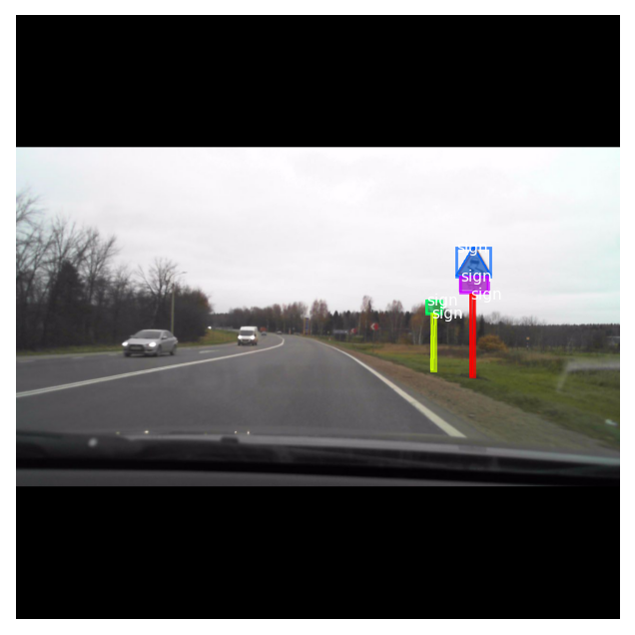
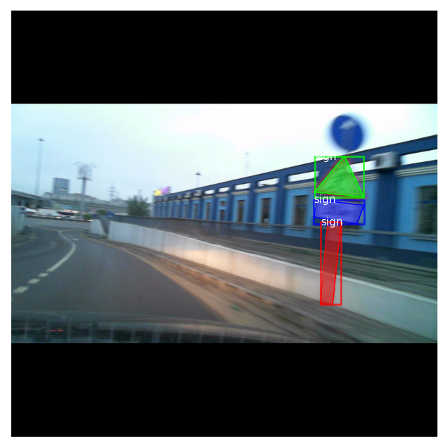
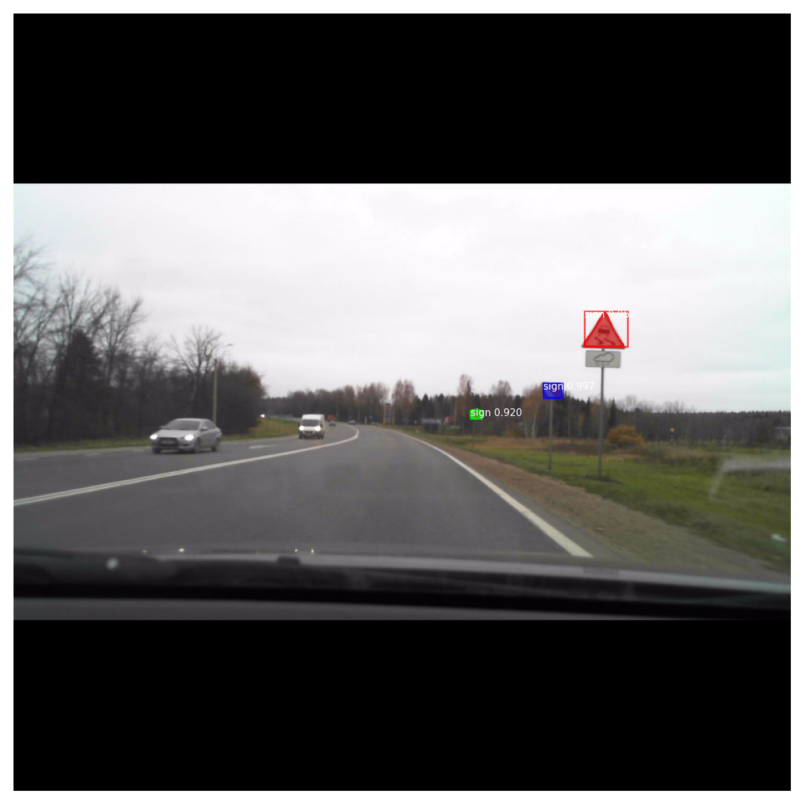
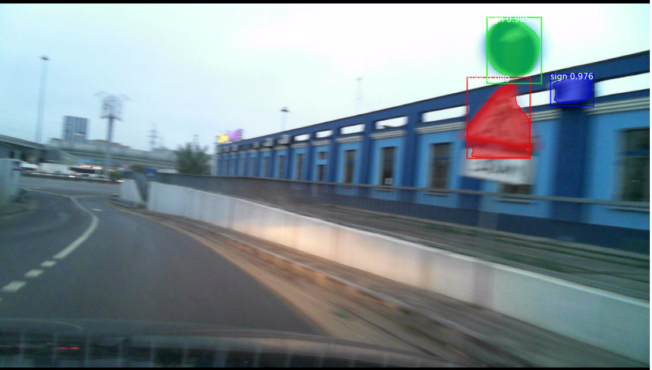

Mask R-CNN Results
Actual bounding boxes:
Key Results:
IoU=0.3015
Precision=0.3712
Recall=0.2632
F1=0.3080
Predicted bounding boxes:

Slide 11
Comparisons
U-Net:
IoU = 0.5194
Precision = 0.7747
Recall = 0.5967
F1 = 0.6439
Consistently performed better
Fairly high accuracy - more false negatives
than false positives
Mask R-CNN:
IoU = 0.3015
Precision = 0.3712
Recall = 0.2632
F1 = 0.3080
Consistently performed worse
Low accuracy - many false positives and negatives

Slide 12
Interpretation and Limitations
Both models need improvement
U-Net:
Low Recall - misses small and distant signs
BCE Loss - predicts everything as background, low loss early in training
Downsampling - may impact recall
Performance improved, then worsened - possibly overfitting
Mask R-CNN:
Poor performance overall - needs hyperparameter tuning
Dataset limitations:
Signposts included in masks/bounding boxes - may confuse models
Notes:
U-Net limitations: likely contributors to low recall (missing those small or distant signs): BCE loss tends to predict everything as background because it has relatively low loss early in training Too much downsampling. I used 4 downsampling blocks which can lower recall
Too much size reduction: 256x256 was probably too small
Mrcnn: many false positives observed, leading to pretty bad performance metrics overall

Slide 13
Acknowledgements
Rob Mulla. (2023, October 5). Build Your First Pytorch Model In Minutes! [Tutorial + Code] [Video]. YouTube. https://www.youtube.com/watch?v=tHL5STNJKag Luke Ditria. (2023, November 13). U-net Image Segmentation the basics (From Scratch!): Pytorch Deep Learning Tutorial [Video]. Youtube. https://www.youtube.com/watch?v=ZoOuNv8TXLs Viacheslav Shalamov and 1 collaborator. Russian road signs segmentation dataset. Kaggle. https://www.kaggle.com/datasets/viacheslavshalamov/russian-road-signs-segmentation-dataset
Rosebrock, Adrian. “Intersection over Union (IOU) for Object Detection.” PyImageSearch, 3 Jan. 2025, pyimagesearch.com/2016/11/07/intersection-over-union-iou-for-object-detection/.
“How Mask R-CNN Works?: Arcgis API for Python: Esri Developer.” ArcGIS API for Python | Esri Developer, developers.arcgis.com/python/latest/guide/how-maskrcnn-works/.
P., Petru. “What Is Mask R-CNN? The Ultimate Guide.” Roboflow Blog, Roboflow Blog, 11 Nov. 2025, blog.roboflow.com/mask-rcnn/.

